Slide 1


Slide 2





SENTIMENT ANALYSIS
PRESENTED BY
SAIPRABHA DAS
(2341004092)
SOUMYASHREE DASH (2341004186)
SHRUTI REKHA SAHOO (2341019084)

Slide 3



SENTIMENT ANALYSIS
Sentiment analysis is a method of analyzing text data to determine the emotional tone of a message, typically classifying it as positive, negative, or neutral
MACHINE LEARNING
Machine learning algorithms are used to train models that can automatically analyze and classify tweets based on their sentiment

Slide 4
SENTIMENT ANALYSIS
Sentiment analysis is a method of analyzing text data to determine the emotional tone of a message, typically classifying it as positive, negative, or neutral
MACHINE LEARNING
Machine learning algorithms are used to train models that can automatically analyze and classify tweets based on their sentiment

Slide 5
SENTIMENT ANALYSIS
Sentiment analysis is a method of analyzing text data to determine the emotional tone of a message, typically classifying it as positive, negative, or neutral
MACHINE LEARNING
Machine learning algorithms are used to train models that can automatically analyze and classify tweets based on their sentiment

Slide 6
Dataset Overview
Data Source: Dataset from Kaggle with labeled sentiments.
https://www.kaggle.com/datasets/abhi8923shriv/sentiment-analysis-dataset/data
Sentiment labels:
0: Negative
1: Neutral
2: Positive
Text data is preprocessed to remove noise, stopwords, and is then stemmed for normalization.

Slide 7
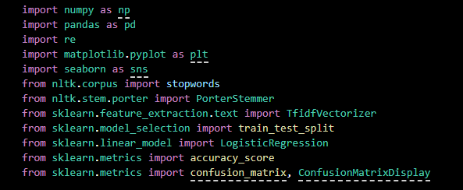
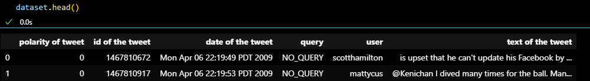

Used Libraries
Loading The Dataset…..

Slide 8
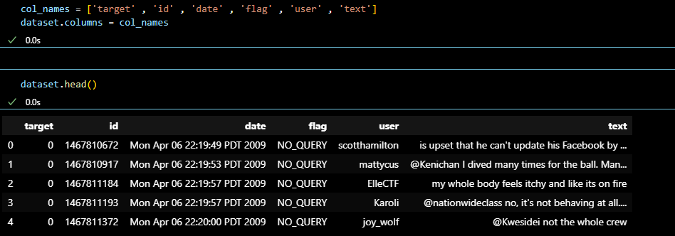
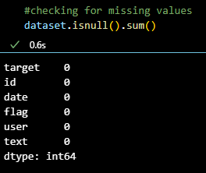
Performing EDA

Slide 9
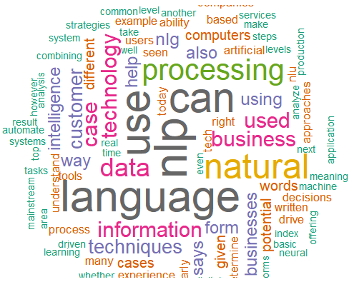
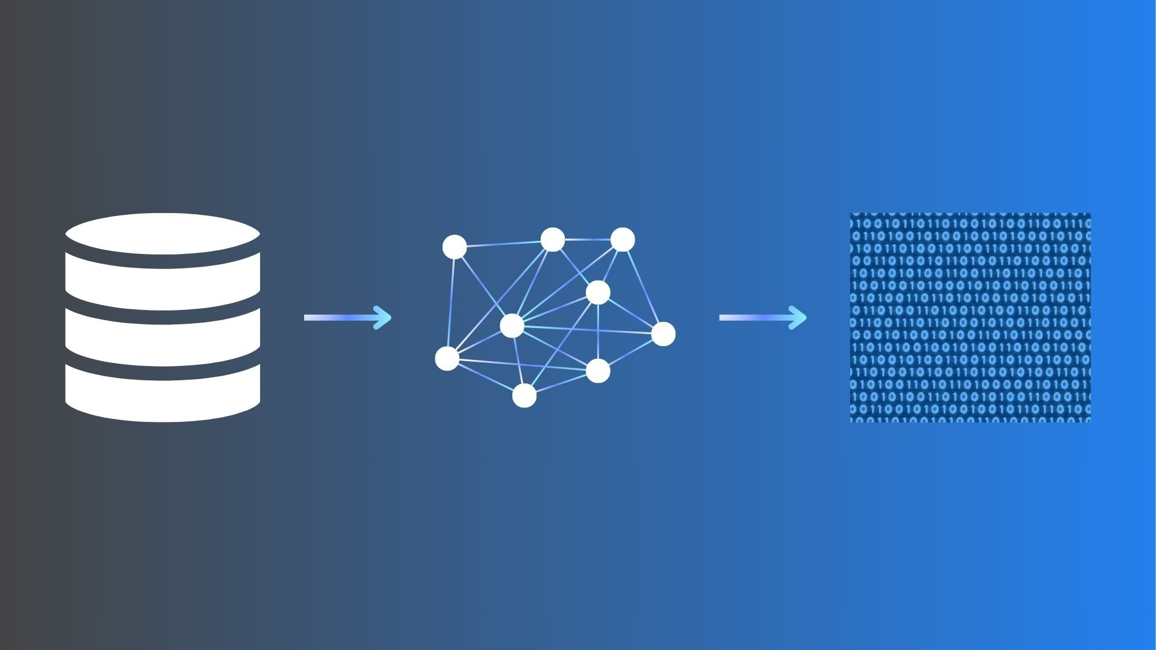

Machine Learning Workflow
Text Preprocessing
Removing non-alphabetic characters using regex.
Converting text to lowercase.
Removing stopwords using NLTK
Applying stemming using PorterStemmer.
Feature Extraction
Vectorization using CountVectorizer or TfidfVectorizer.
Transforms text into numerical feature vectors.
Captures frequency or importance of terms.
Model Building
Training a machine learning classifier (e.g., Logistic Regression, Naive Bayes).
Model learns patterns to distinguish between sentiments.
Evaluated using accuracy, precision, recall, and F1-score.

Slide 10
Text Preprocessing
Removing non-alphabetic characters using regex.
Converting text to lowercase.
Removing stopwords using NLTK
Applying stemming using PorterStemmer.
Feature Extraction
Vectorization using TfidfVectorizer.
Transforms text into numerical feature vectors.
Captures frequency or importance of terms.
Model Building
Training a machine learning classifier (e.g., Logistic Regression, Naive Bayes).
Model learns patterns to distinguish between sentiments.
Evaluated using accuracy, precision, recall, and F1-score.

Slide 11
Model Evaluation
Confusion matrix to visualize performance across sentiment classes.
Classification report shows precision, recall, and F1-score.
Helps identify which sentiments are being misclassified.

Slide 12
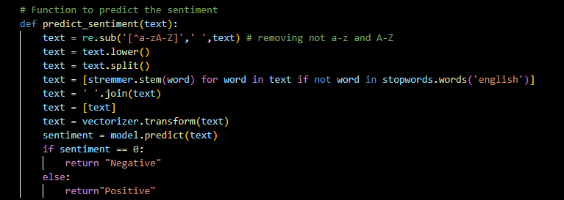
Sentiment Prediction Function
Input text is preprocessed and vectorized.
The model predicts the sentiment class.
Returns 'Positive', 'Neutral', or 'Negative' based on prediction.

Slide 13
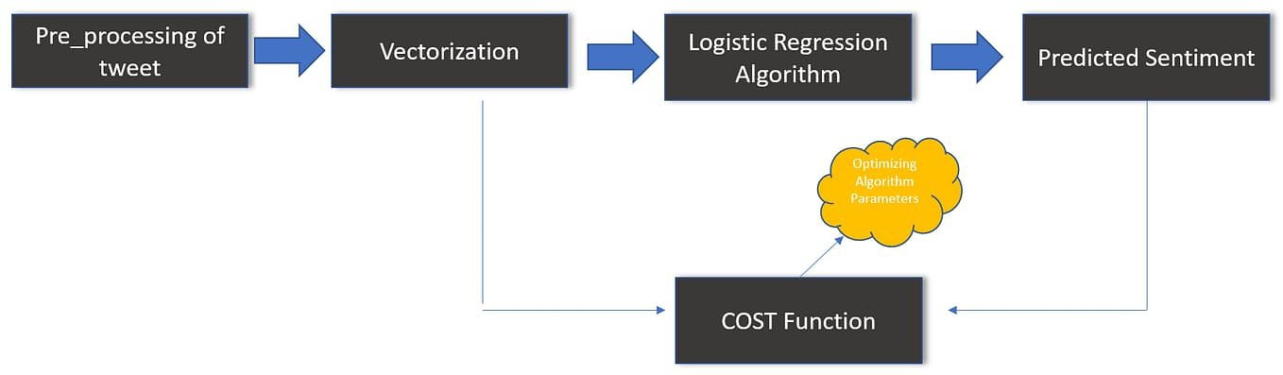
Logistic Regression Classification

Slide 14

Implementing Logistic Regression for sentiment analysis
Key Findings:
Logistic Regression is a powerful machine learning algorithm for sentiment analysis.
It can accurately classify tweets into positive, negative, or neutral sentiments.
By setting a threshold, we can classify the texts as positive or negative or neutral based on the predicted probabilities.

Slide 15

RESULT ANALYSIS
Classification Report:

Slide 16
Potential Areas For Improvement
Exploring Other Machine Learning Models
Fine-tuning Model Parameters
Handling Imbalanced Datasets
.
Diving into Neural Networks

Slide 17
Conclusion
Sentiment analysis helps businesses and researchers understand public opinion.
Text preprocessing and model choice significantly affect performance.
Machine learning enables scalable, real-time sentiment classification from social media.

Slide 18
References
https://www.geeksforgeeks.org/what-is-sentiment-analysis/
https://images.google.com/ (For Attached Images)
https://www.kaggle.com/datasets/abhi8923shriv/sentiment-analysis-dataset (For Dataset)

Slide 19
THANK YOU

